Slide 1
Online Tests for Learning Disabilities
Group Watson Medical
for The Seminar Q&A with IBM Watson

Slide 2
Introduction
Specific Learning Disabilities
Present options
Our approach
The Role of A.I (Watson)
Prototype Demo
Conclusion
Future scope
References

Slide 3
Introduction
Using AI to tackle problems in Learning Disabilities
Enable Parents and Teachers to discover faster and more accurate the problem
Providing a more playful process for the kids, without minimizing results
Home based approach – reducing time loss

Slide 4
Specific Learning Disabilities
receive
process
understanding and
using language
recall
Definition
Basic psychological
processes
communicate
Reading(Dyslexia)
Writing(Dysgraphia)
Spelling
Math(Dyscalculia)
Auditory Processing
Visual Processing
Sensory-Motor
Social

Slide 5
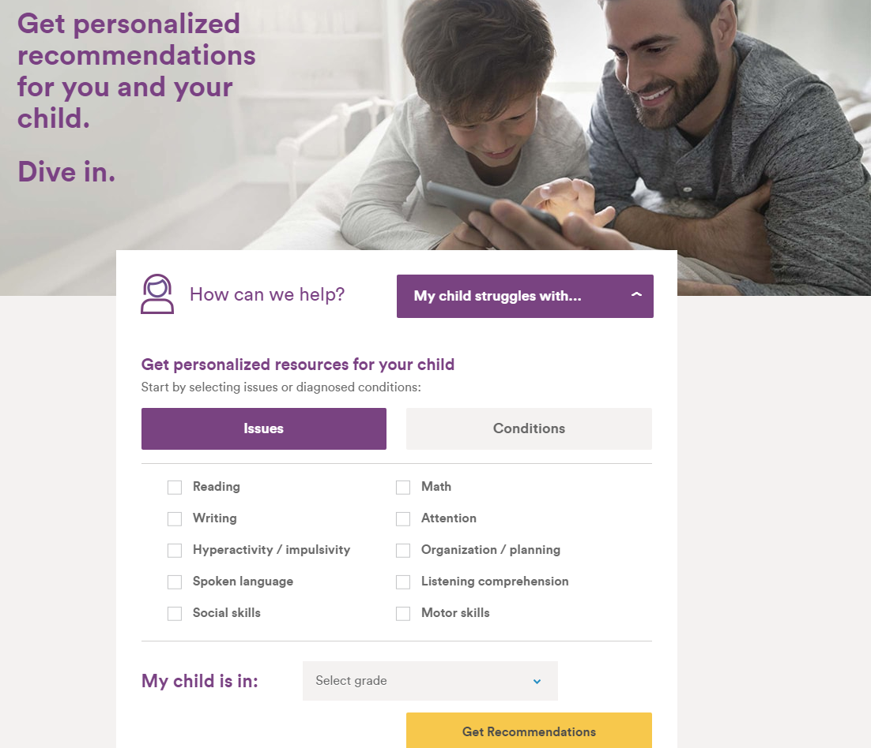
Present Options
The test are based on parent input according to their observations
Various products can be also purchased for the kids to improve their skills in various disabilities
This approach is considered adequate but not enough feedback of the progress of the kid

Slide 6
Our Approach
Test for Visual Recognition
Test for Natural Language Processing
Better fit to the kid’s needs
Customizable Interface
More fun for the kid
Tutor interface for surveillance
Increased frequency for better results

Slide 7
The Role of A.I (Watson)
Condensed access for the tutors/supervisors
Less time consuming for all parties (Kids, Parents, Tutors)
Better evaluation
Training/Learning paterns for the Database improved over time

Slide 8
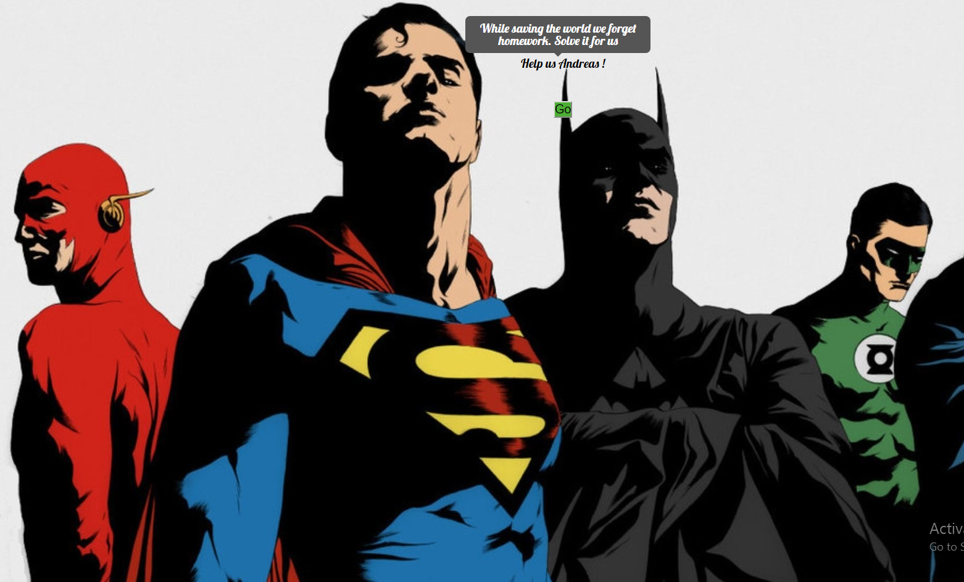
Prototype Demo
Now is the time for the Demo presentation
Please feel free and comment at the end.

Slide 9
Demo Workflow
Customizable for girl/boy
Login page – Name,Age
Task 1 – Draw a shape in canvas
Task 2 – Choose similar correct words from lists
Submit

Slide 10
Demo Workflow - tutor
Tutor Login page
Search bar for given kid’s name
Results page for both tasks in the scale of 10, comment text field

Slide 11
Conclusion
On the scope of our project:
AI can improve our abilities and open doors of vast opportunities
It makes knowledge easily accessible
Usability in various applications is improved
Interaction with adjusted levels according to the kid’s needs

Slide 12
Future scope
More tests with Grammar and Math options
Overall history of the attempts of each particular kid
Mobile/Tablet application interface
Involve AI in more aspects of the Application
Enlarging the Database
Incorporating more languages

Slide 13
References
https://www.understood.org/en
https://www.youtube.com/watch?v=yG_xSBsFMPQ&list=PL51B3C6F1BC86B138&index=2
External Advisor : Tania Sakaltra

