Slide 1
Introduction to the GPGPU (General-purpose computing on graphics processing units) and to OpenCL
Prof. Dr.-Ing. Andreas Maier, Prof. Dr.-Ing. Dietmar Fey
Jessica Magaraggia, Martin Berger, Frank Schebesch
Notes:
Reminding the truth

Slide 2
Outline
Background and history
Overview of the graphic pipeline
GPGPU architecture
Cuda
OpenCL
OpenCL example

Slide 3
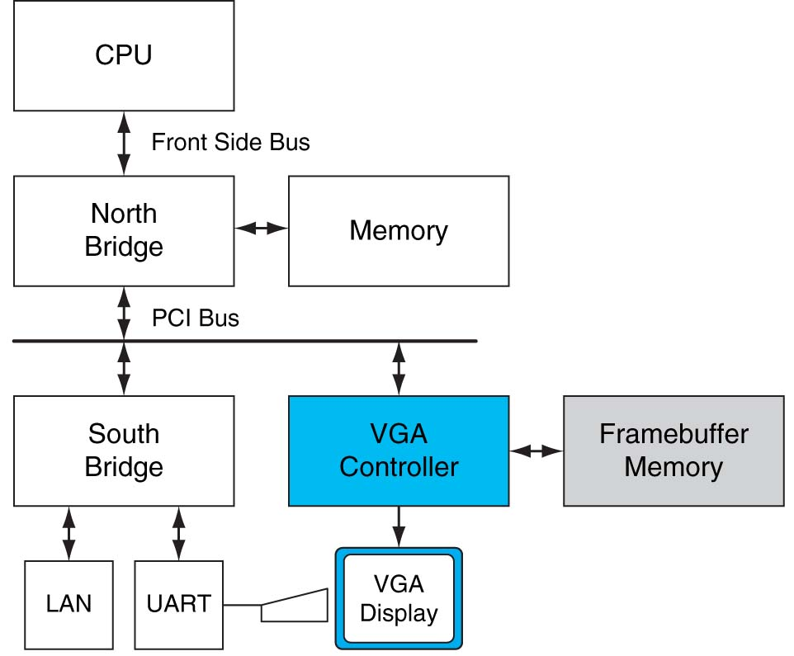
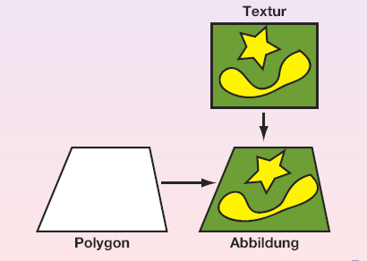
GPGPU – General Purpose Graphics Processing Unit
Graphics cards: Short background
Original use: Control of the PC‘s monitor by means of the graphics cards
Middle of the 80es: Graphics cards with 2D-acceleration
Beginning of the 90es: First 3D-Acceleration

Slide 4
GPGPU – Introduction (1)
At the beginning, no standard programming interface was available
Early 90es:
Establishment of OpenGL in the professional context
The fast development lead to successful spread in the market shares
End of the 90es:
Graphics cards take over in the context of coordinate transformations and of Illumination (e.g. NVIDIA GeForce 256)
The term Graphics Processing Unit appears in the scientific community
2000es: Shader-Programming ( Pixel-Shaders and Vertex-Shaders are used for graphic rendering)
Nowadays:
Graphics cards manufacturers: ATI und NVIDIA
High demand on the market → low prices

Slide 5
GPGPU – Introduction (2)
Summary of the graphics cards‘ development:
VGA Controller Memory Controller Display Generator
GPU (Graphics Processing Unit) The Processing of the traditional graphic pipeline
GPGPU (General Purpose Graphics Processing Unit) Programmable processors replaced fixed function blocks Increased computational accuracy Parallel programming is required → CUDA

Slide 6
OpenGL – Graphic Pipeline
Shader
It is the program in charge of the shadowing
It acts on junction points, (vertices), on geometric primitives (vertices, lines, triangles, etc.) and single points in the image
Some units are programmable (blue), some are hardwired (white)
Textures
They describe characteristic of the points on a surface
Interpolation is done on floating points
Often disregarded in 1D, 2D- oder 3D-fields
Notes:
Vertex Shader: transformiert die 3D Position eines Knotens auf den 2D Schirm. Geometrie Shader kann geometrische Primitive in die Szene einfügen und herausnehmen. Setup und Rasteriserungseinheit erzeugt Pixelfragmente für ein geometrisches Primitiv. Pixel Shader greifen häufig auf Texturen zu, die Musterungen von Objekten beschreiben.

Slide 7
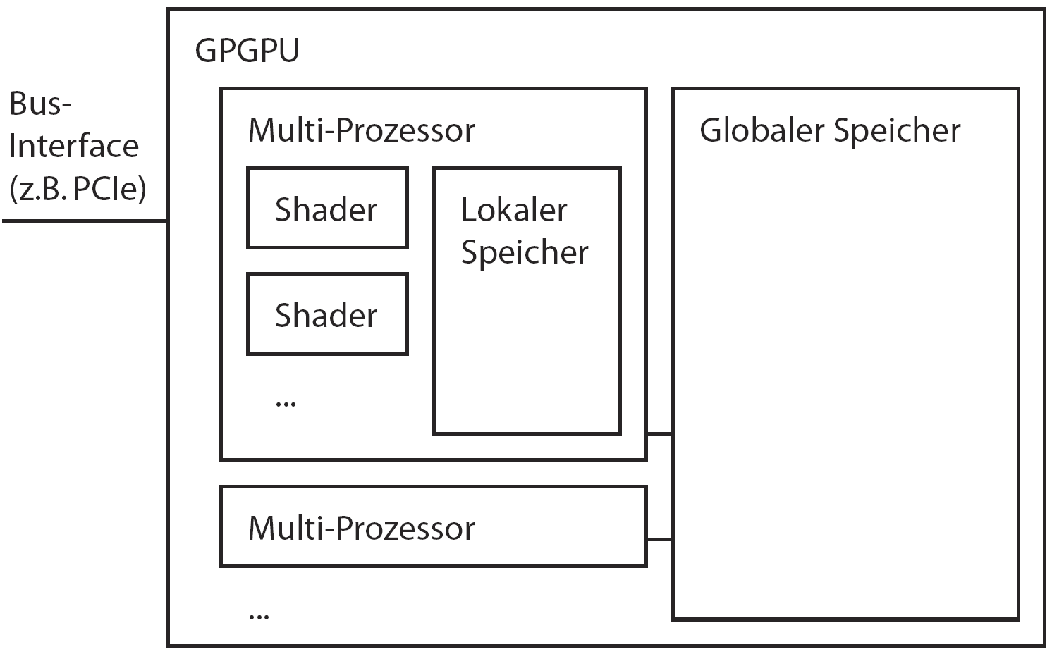
GPGPU – Architecture (1)
General configuration of a GPGPU

Slide 8
GPGPU – Architecture (2)
Hierarchy of the memory of a GPU:
Global memory
Located in an external DRAM
Not explicitly accessible by a CUDA-program
Accessible just by a thread at a time
Shared memory
Located in specific SRAM-banks
SM-specific
Notes:
Textur-Prozessor-Cluster Heterogene Multikern-Architekturen

Slide 9
GPGPU – Architecture (3)
Local memory
Thread-specific
Located in external DRAM
Configurable
Special memory
Textures
Constants
Both local and special memory are of type constant. They are writable by the CPU at the beginning of the computation on the graphics card

Slide 10
GPGPU – CUDA-Programming Model
CUDA supports:
Parallel threads
Programming schemas with parallel data
Difference w.r.t. other parallel threads approaches:
All threads need to perform the same operation
In this context we talk of data parallelism
Nvidia refers to this schema as: SIMT (Single Instruction Multiple Threading)
Nevertheless it is possible to switch between threads of a specific thread field during an application

Slide 11
OpenCL Platform
The OpenCL platform includes several components
One Host (CPU-based)
Compute Devices (GPU)
Compute units ( groups of execution and arithmetic units)
Processing elements (executing OpenCL Kernels)
Serial code executes in the Host
Parallel code executes in the Compute devices
HOST
Compute Device
Processing Element
Compute unit
Woolley2011
Notes:
Compute Units” (akin to execution units & arithmetic processing unit groups on multi-core CPUs - think “cores”)
At the lowest level, these processing elements all execute OpenCL “Kernels

Slide 12
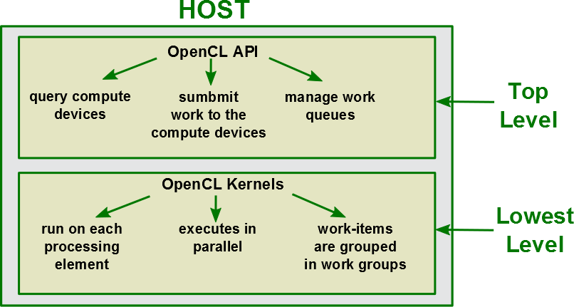
OpenCL: How the execution works
Notes:
The Host is run by the application. On the host side, blocking API functions can perform
waits for certain events to complete, such as all events in the queue
to finish, specific events to finish

Slide 13
OpenCL Kernels
An OpenCL Kernel represents the code executed by a Work item
Kernels process in parallel: their execution needs to be independent from one another
The code executed by the kernels needs to consider the required memory access

Slide 14
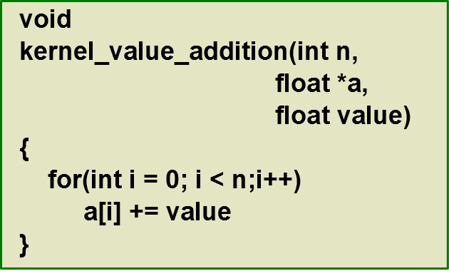
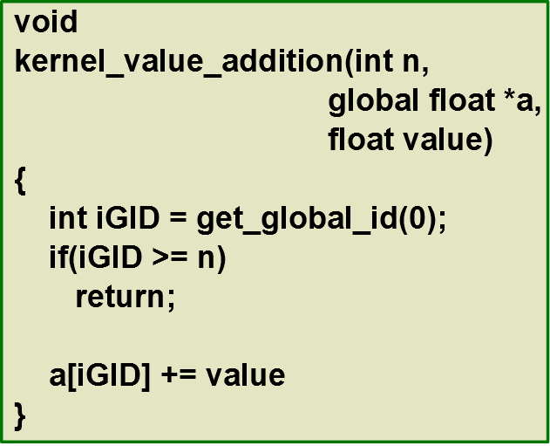
Example of an OpenCL Kernel
Standard loop: The same code is repeated serially, one element after the other
OpenCL kernel: The same code is executed at each point in the domain in parallel

Slide 15
Work Domain 1D
Vector a
Working item
get_global_id(0) = 8
Vector a
Working group
Global size: 20
Local size of the working group: 8

Slide 16
Work Domain in 2D
Example: Point-wise image processing
The image represents the global dimension of the working domain (16 x 20)

Slide 17
Work Domain in 2D (2)
The global domain is divided into work items (e.g. a pixel)

Slide 18
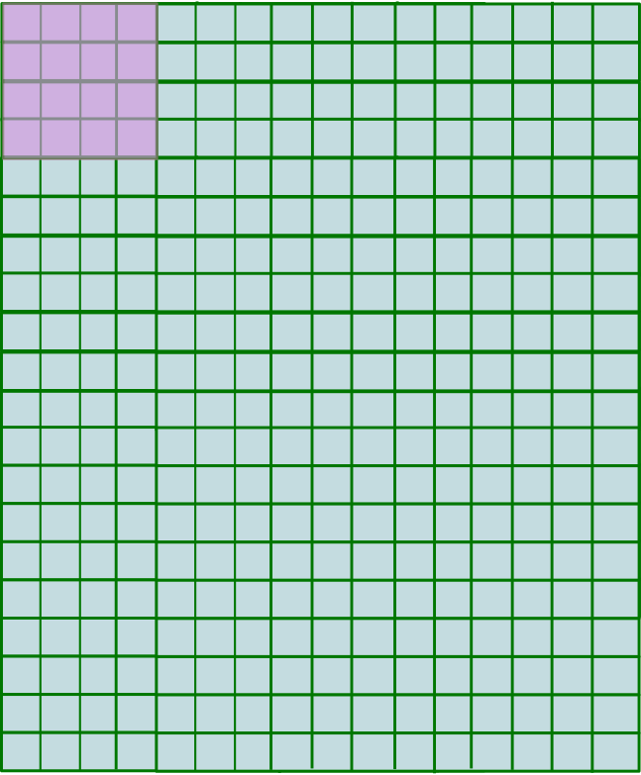
Work Domain in 2D (3)
The global domain is divided into work items (4 x 4)
Work items are grouped in work groups which execute together
The work domain can be in practice bigger than the real size of the image
It needs to be a multiple of the worksize

Slide 19
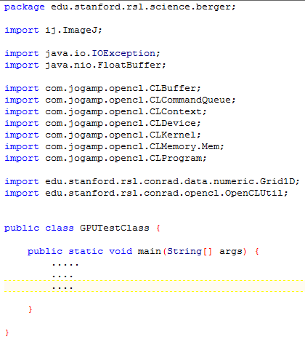
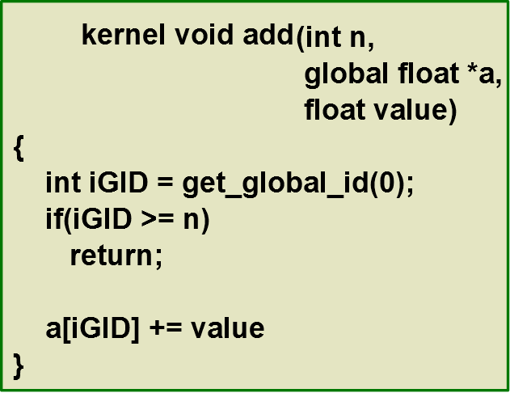
Example of a GPU class (1)
We want to write a class that uses our addition kernel:
Code used with courtesy of Martin Berger

Slide 20
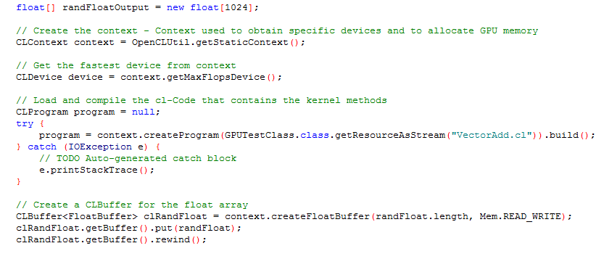
Example of a GPU class (2)
Code used with courtesy of Martin Berger

Slide 21
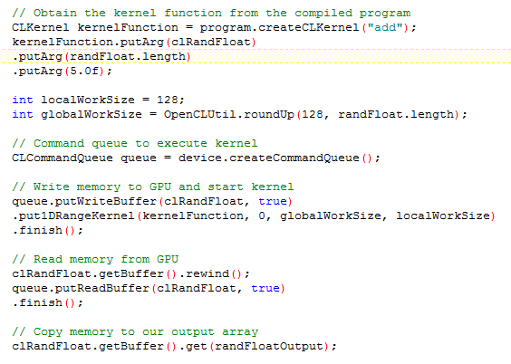
Example of a GPU class (3)
Code used with courtesy of Martin Berger

Slide 22
References
Woolley2011: http://www.cc.gatech.edu/~vetter/keeneland/tutorial-2011-04-14/06-intro_to_opencl.pdf
Khronos2010: https://www.khronos.org/assets/uploads/developers/li-brary/overview/OpenCL-Overview-Jun10.pdf
Smith2013: http://www.cs.bris.ac.uk/home/simonm/workshops/Op-enCL_lecture4.pdf

Slide 23
Questions?

